Slide 1
KOKO Mobile App Strategy

Slide 2
Introduction
Objectives
Benefits
Approach
Project Plan
KOKO Mobile App Roadmap

Slide 3

Introduction
The KOKO mobile app ecosystem has so far been built on a needs based approach, where mobile apps have been developed based on ad hoc requirements and scaled as business requirements have changed, but without a proper long term strategy or alignment with long term business goals.
This has resulted in a huge functional gap between business needs and mobile app availability to KOKO businesses and users, leading to limited off-site productivity.
This document is therefore intended to identify essential business requirements need/might benefit from mobile applications, identify gaps and to create a new mobile app roadmap in line with business needs and long term business strategies.

Slide 4
Objectives
The objectives of this project are are:
The need to identify the business requirements of departments/user groups
The need to create detailed documentation of existing mobile app landscape
The need to identify mobile app usage by different user groups in KOKO
The need to create a map of all user groups and their needs requiring an app
The need to identify the user pain-points in the current KOKO apps
The need to identify the functional gaps in KOKO mobile apps

Slide 5
Approach
In order to capture the exact user needs for mobile applications in the different KOKO operations, my approach is conduct thorough end user interviews, then supplement this information with external research, as well as Google Play Store statistics and user feedback.
The results achieved are then processed in the following steps:
Capturing business mobile app requirements
Documenting KOKO apps in use
Identifying mobile app user pain points
Identifying business functional gaps
The acquired information will then be used to build a prioritized list of mobile app requirements that should inform a new mobile app development strategy and roadmap for the next year.

Slide 6
KOKO User Groups
KOKO Kenya
Commercial
Operations
Customer Sales
Network Operations
Customer Care
Fuel Operations
Agent Network
Cooker Operations

Slide 7
KOKO User Groups In Scope
KOKO user groups in scope have been identified on the operations level. These discrete KOKO operations are as follows:
Network Operations
Fuel Operations
Cooker Operations
Customer Sales
Customer Care
Agent Network

Slide 8
Network Operations (Production)
RESPONSIBILITIES:
KOKO Production Ops is tasked with the production of network hardware. These include:
Smart Depot System (SDS)
Smart Tanker System (STS)
KOKOpoints (KPs)
KOKO Cookers
They also conduct Quality Control (QC) and Quality Assurance (QA).
They don’t require mobile applications and are situated in India.
This not in scope for this project.

Slide 9
Network Operations (Deployment)
RESPONSIBILITIES:
The Deployment Ops team is responsible for the following functions:
Agent Shop inspections
Civil Works to prepare for KP installation
Installing KPs in Agent shops
Setting up Smart Tanker Systems (STS) in KOKO tankers
Setting up Smart Depot Systems (SDS) in Vivo Energy fuel depots
STS and SDS installation are out of scope as they don’t require any supplementary tools.
Agent Shop inspections, Civil Works and KP installation are in scope.

Slide 10
Network Operations (Deployment)
1. AGENT SHOP INSPECTION:
This is done in order to ascertain that the applicant shop conforms with KOKO requirements for KP installation. These requirements include:
Shop safety preparations
KP location
Refill box location
Micro-tanker parking availability
Inspection workflow:
Agent inspection planning
Inspection team visits Agent shop
Agent shop data captured
Analysis done to determine qualification
Inspection planning is done on Google sheets
Agent shop data captured using Google forms
Agent shop qualification done using Google sheets

Slide 11
Network Operations (Deployment)
2. CIVIL WORKS:
This is performed by either KOKO staff or using contractors. The purpose of this is to prepare the Agent shop for KP installation. Responsibilities include:
Mounting the L frame
Mounting the refill box bracket
Route power to KP location
Create space for KP
Civil works workflow:
Civil works planning
KOKO/contractor performs civil work at Agent shop
QA team performs quality check on civil works
Reporting on QA is done
Civil works planning is done on Google sheets
QA team performs quality checks using Google forms
QA reporting is done using Google sheets

Slide 12
Network Operations (Deployment)
3. KP INSTALLATION IN AGENT SHOPS:
Once an Agent shop has been approved for KP installation, the deployment teams carries out the installation.
KP Installation workflow:
KP installation schedule planning
KP is transported to the Agent shop
Deployment team installs new KP in Agent shop
Reporting is done using Google sheets
KP installation planning is done on Google sheets
Driver reports on KP status using Google forms
Task scheduling and planning is done using Google sheets
Daily installation reports done in Google sheets

Slide 13
Network Operations (Deployment)
MOBILE APPS IN USE:
None
FUNCTIONAL GAPS:
The following functional gaps exist in Deployment ops:
Planning for deployment operations is done entirely on Google sheets. This is time intensive and leads to delays in updating data.
QA team for civil works inspections rely on Google forms for reporting. This can be tedious and inefficient as the data is sent to a Google sheet.
Agent shop inspection team have to take photos on their phones and upload them to Google drive before linking them to the relevant agent records in Google sheets. This is time consuming and can also lead to errors when linking to Agent records in the spreadsheet.
There is no direct sharing of data e.g Agent shop and KP data between different teams with related functions e.g. the deployment and inspection teams.
Spreadsheet records can easily be tampered with, both intentionally and unintentionally, as there are no user privileges assigned to different user roles.
Reporting from spreadsheets are both tedious and time consuming to conduct.

Slide 14
Network Operations (Quality)
RESPONSIBILITIES:
Quality (calibration) team are responsible for ensuring that KPs are correctly adjusted to dispense fuel correctly. After a KP is installed in an Agent’s shop, it is fueled by the Fuel ops team. After this, the calibration team does adjustments to ensure it is ready to dispense fuel.
Calibration workflow:
KP calibrations planning
Calibration team visits Agent shop
Calibration performed on KP at Agent shop
Calibration report updated in planning docs
Calibration planning is done on Google sheets
Task schedules provided on AppSheet mobile app
Calibration process provided by AppSheet mobile app
AppSheet app updates records on the Google sheets

Slide 15
Network Operations (Quality)
MOBILE APPS IN USE:
AppSheet android app
APPSHEET USER PAIN POINTS:
AppSheet doesn’t store calibration data in KOKO Core. Calibration records have to be copied manually into KOKO Core, resulting in duplicate data.
AppSheet relies on a Google Cloud application and requires Google sheets to work, meaning that the team has to rely on spreadsheets for their roles.
AppSheet capabilities have to be programmed on Cloud, limiting access to KOKO Core and its embedded services.

Slide 16
Network Operations (Quality)
FUNCTIONAL GAPS:
The following functional gaps exist in the Quality (calibration) ops:
Planning for deployment operations is done entirely on Google sheets. This is time intensive and leads to delays in updating data.
Reporting from spreadsheets are both tedious and time consuming to conduct.
KOKO is dependent on Google Cloud for the entire operation. The calibration data is stored outside KOKO Core.

Slide 17
Fuel Operations
RESPONSIBILITIES:
KOKO Fuel Ops is tasked with the responsibility of delivering quality fuel to KOKO fuel customers. It leverages the use of custom technology to facilitate this function.
There are 3 players involved in the operation:
Vivo Energy
Transporters (contractors)
KOKO Networks
Vivo Energy:
They source ethanol fuel on behalf of and with KOKO Networks specifications. Imported fuel reserves are stored at their depot in Mombasa, while local reserves are stored at Vivo petrol station depots.
Transporters:
These are contractors who are tasked with transporting fuel from depots to KOKO agent shops (KPs). They use micro-tankers to transport fuel.
KOKO Networks also own and operate their own fleet of micro tankers.

Slide 18
Fuel Operations
RESPONSIBILITIES:
3. KOKO Networks:
KOKO Networks acts as both customer and supplier in fuel operations. It is a Vivo Energy customer and uses SDS
to interact with Vivo fuel depots. It is also a supplier, using the STS to transfer fuel from micro tankers and KOKOpoints (KPs).
MOBILE APPS IN USE:
KOKO Operator App (KOA)
KOKO Operator App Functions:
Synchronizing activities between the SDS and the STS
Issue reporting e.g. agent shop closed, road conditions, etc.
Navigating to fuel depots and KPs using Google maps
Task management (sequence of daily tasks)
Provide planning information used for allocating KPs to tankers, allocating refills to KPs and monitoring all micro tankers.

Slide 19
Fuel Operations
KOA PAIN POINTS:
Simplicity of the UI has limited the number of possible functionalities.
Feedback loop is limited, e.g. reporting, which can only be done at the end of the day.
Operators don’t have the ability to to send alerts and ask for support from the app interface.
Task management is not flexible. Operators have no ability to modify task sequence.
FUNCTIONAL GAPS:
Fuel quality measurement at fuel depots is manual and results must be sent to KOKO using WhatsApp.
There’s no performance monitoring tool for operators
Process delays requiring intervention cause unnecessary delays to both operators and KOKO agents
Operators have no issue reporting tool. They have to make phone calls to get support

Slide 20
Cooker Operations (Warehousing)
RESPONSIBILITIES:
Warehousing ops is responsible for receiving KOKO cooker kits from India.
Warehousing pipeline:
Purchase Order is raised
Cooker kits shipped to Kenya
Cooker kit serials scanned into Google sheets
Cooker kit serials transferred to ERP
PO is raised based on sales order
Scanning done using Zebra scanner
Serials copy/pasted into ERP Inbound

Slide 21
Cooker Operations (Warehousing)
APPS IN USE:
KOKO Mile
KOKO Mile Usage:
Receive kits into the ERP using the cooker receipt module.
Perform internal transfers between different locations e.g between service location and the loading bay.
KOKO MILE PAIN POINTS:
Bulk scanning of kits can lead to synchronization failure with the ERP. This has led to time delays in scanning as users have to scan a maximum of 100 records at a time, out of an average of 2400 in a consignment.
WAREHOUSE FUNCTIONAL GAPS
The ERP internal transfer function is buggy, leading to errors when transferring kits between ERP locations.
There is no singular QR code for the entire consignment.
The bulk synchronization function with the ERP is broken, leading to delays in kit transfers.

Slide 22
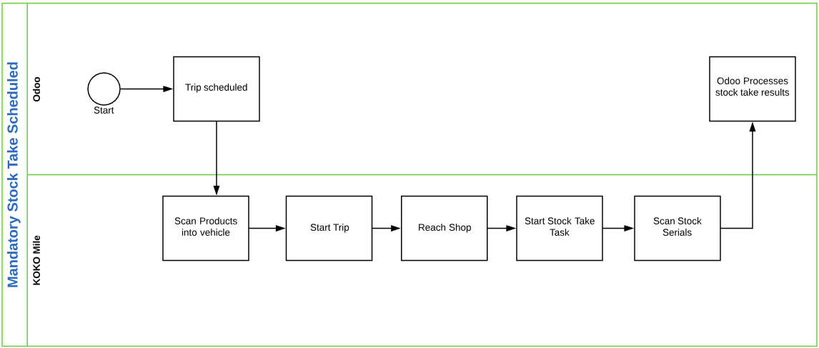
Cooker Operations (Dispatch)
RESPONSIBILITIES:
The cooker dispatch team is responsible for:
Picking customer orders
Coordinating the tracking and delivery of cooker kits to KOKO agent shops.
Stocktaking of cooker kits in KOKO agent shops
Navigation using Google maps
Cooker delivery process:
Scan products into vehicle
Start trip
Reach shop
Start stock take task
Scan stock serials
Using the KOA app
Navigation using the KOA app
Stock taking using the KOA app

Slide 23
Cooker Operations (Dispatch)
APPS IN USE:
KOKO Mile
KOKO MILE PAIN POINTS:
Frequent failures synchronizing data with the ERP.
The stocktaking clerk can scan only 1 kit, leading to the rest of the stock being moved to missing stock.
Reverse logistics isn’t done in the app, rather manually using a delivery note.
FUNCTIONAL GAPS:
Reverse logistics is done manually. This is both tedious and time consuming.
There’s no way to ensure that stocktaking clerks complete the process for all kits in an agent shop.
Failed synchronization of kits in the ERP has led to missing records/repeated tasks.

Slide 24
Cooker Operations (Cooker Service)
RESPONSIBILITIES:
The cooker service operations is responsible for cooker after-sales service.
They are composed of 2 teams
a). Field Service team:
The Field Service team is responsible for cooker repairs at customer locations. Their functions include:
Cooker repair
Swap cooker parts
Cooker swap
Canister swap
b). Part Repairs team:
The team is responsible for processing defective cooker parts returned by the Field Service team. Their functions include:
Repair repairable parts
Scrap irreparable parts

Slide 25
Cooker Operations (Cooker Service)
COOKER SERVICE PIPELINE:
The cooker service operations is responsible for cooker after-sales service.
Customer Complaint
Customer Service
Field Service Schedule
Cooker Repair
Sparepart maintenance
Phone
SMS
WhatsApp
Zendesk/Freshdesk tickets
Field Service tracker spreadsheet
Cooker repair
Part swap
Cooker kit swap
Part repair
Part scrapping

Slide 26
Cooker Operations (Cooker Service)
MOBILE APP REQUIREMENTS:
Field teams need the capability to preview scheduled field visits. This will reduce the amount of time used to prepare for field visits each morning.
Service teams need to be able to view the spare parts available in their toolboxes. This information will be useful in determining the parts they need to add to their toolboxes for the day’s visit.
Service teams need instructional guides available to them in the field. This will reduce their reliance on office support for cooker repairs.
Service teams need the capability to capture part numbers and update them in the inventory management system automatically. This will be useful in part tracking for management.
Service teams need the ability to add notes and comments to customer tickets created by Customer Care. This will reduce inaccuracies in reporting on cooker repairs.
Service teams need the capability to perform canister replacement in the field. This will reduce execution time.
Service teams need the capability to reassign cookers in the field without the help of Customer Care. This will reduce both execution time and reliance on Customer Care staff.

Slide 27
Cooker Operations (Cooker Service)
MOBILE APPS IN USE:
None
FUNCTIONAL GAPS:
Field service teams have no ability to preview their daily field visits, which would reduce time wasted every morning preparing for field visits.
Field service teams have difficulty managing their toolboxes as they have to review the Field Service Tracker spreadsheet for spare part requirements.
There are no instructional guides available to field service teams in the field. In case they need guidance in performing repairs, they have to call into the office for assistance.
Spare part and cooker kit swaps require documenting serial numbers. This has to be done manually by taking pictures and submitting to the system at the end of the day.
Technicians have to submit notes and comments about repairs into the service tracker spreadsheet at the end of each day. This can lead to inaccurate information being fed back to the system.
In case of faulty canisters or cooker replacement, technicians have to call in to Customer Care, which will perform the swap in KOKO Core. This process is slow and resource intensive.
There’s difficulty tracking part movement. All spare parts are tracked using spreadsheets, which has made it difficult to locate them.

Slide 28
KOKO Agent Network
The KOKO Agent Network is responsible for managing KOKO Fuel agents. It is composed of the following teams:
Agent Sales
Agent Expansion
Agent Care

Slide 29
KOKO Agent Network (Agent Sales)
RESPONSIBILITIES:
Agent Sales team is responsible for:
Selling KOKO products e.g. cooker kits to KOKO agents.
Manage Agent/KOKO relationship using a team of relationship managers and representatives.
Demarcation of Agent Network zones.
Agent Sales team uses SMS to send sales targets and alerts e.g. agent visits.
MOBILE APPS IN USE:
WhatsApp (WhatsApp groups)
myKOKO Sales app
The Agent Sales team uses WhatsApp groups to communicate with KOKO agents.
KOKO Agents on the other hand use myKOKO Sales app to manage their profiles, view their sales progress and register new leads.

Slide 30
KOKO Agent Network (Agent Sales)
WHATSAPP PAIN POINTS:
WhatsApp is a 3rd party application, meaning that all the features are general and not easy to use for sales operations.
WhatsApp features can’t be upgraded or extended by KOKO to serve the intended purpose.
If WhatsApp is discontinued by Facebook, then historical and ongoing conversations are all lost.
myKOKO PAIN POINTS:
myKOKO app is generalized for both customers and agents. This has led to limited features for both user groups.
KOKO agents have more requirements than customers, which suggests a separate mobile application for agents.

Slide 31
KOKO Agent Network (Agent Sales)
AGENT SALES FUNCTIONAL GAPS:
KOKO agents need to view their sales progress including leads, savings orders, paid orders, sales and cancelled orders easily from one location.
KOKO agents need visibility of every customer they have recruited.
KOKO agents want to view all their active leads. Currently, active leads are not visible in myKOKO app after 3 months.
KOKO agents want to view their expiring leads. All leads are set to expire after 6 months.
KOKO agents want to view their performance vs targets.
KOKO agents want visibility of their fuel sales, which is currently not available, nor easy to obtain.
KOKO agents want to view their monthly performance ranking e.g. gold, silver, bronze etc.
SMS is not an effective tool for sending adequate information to agents due to the character limitation.
Agent sales team need a more effective means of communication with agents, which would replace WhatsApp for sending sales targets and agent alerts.

Slide 32
KOKO Agent Network (Agent Expansion)
RESPONSIBILITIES:
Agent Expansion team is responsible for:
Recruiting/onboarding new KOKO agents.
Offboarding/removing non-performing KOKO agents from Agent Networks.
Increase the number of KOKOpoints to 1000 by the end of the year (2021).
MOBILE APPS IN USE:
None
FUNCTIONAL GAPS:
Agents have to use Google sheets to capture leads information. This is tedious and time consuming.
Agents have to use WhatsApp groups to communicate with the support team at KOKO, which is inconvenient and doesn’t capture all the information accurately
Reporting is difficult when using Google sheets to capture data.

Slide 33
KOKO Agent Network (Agent Care)
RESPONSIBILITIES:
Agent Care team is responsible for:
Interfacing between KOKO agents and KOKO Networks.
Maintain the database on KOKO agents.
Receiving new agent leads from Agent Expansion team and onboards the new agents.
Updating new agent information into KOKO Core
Managing new KOKO agents
Handling all agent issues, including contracts, payments, commissions, etc.
MOBILE APPS IN USE:
None
Agent Care doesn’t require mobile applications at this time.

Slide 34
Customer Care
RESPONSIBILITIES:
The KOKO Networks customer care department provides KOKO Fuel customers and partners with relevant information, KOKO products usage advice & customer service, including canister replacement, cooker repairs, and cooker replacements.
There are 3 distinct sections (operations) within the Customer Care department. These include
Inbound CC team
Outbound CC team
Field Service team
N/B:
The Outbound team is not in scope as they don’t require mobile apps to perform their functions.
The Field Service team is not covered here as their role is detailed under Cooker operations.

Slide 35
Customer Care (Inbound Team)
RESPONSIBILITIES:
The Inbound is responsible for resolving customer triggered support queries. These queries come from a number of channels including phone calls(~96%), SMS(~3%), Whatsapp(~1%) and Facebook (minuscule). Inbound queries are managed using Zendesk CRM (and Freshdesk for WhatsApp soon), as well as Google sheets.
APPS IN USE:
WhatsApp
WHATSAPP USER PAIN POINTS:
WhatsApp processing of part and kit serial numbers is slow and has multiple steps, leading to mistakes, lost data and process inefficiencies.
WhatsApp doesn’t have capabilities for capturing data and transferring to KOKO Core directly.
WhatsApp doesn’t have capabilities for tracking and managing field visits.

Slide 36
Customer Care (Inbound Team)
FUNCTIONAL GAPS:
Have to use a WhatsApp group chat to support the Field Service team. This is slow, leading to a decrease in productivity.
Manual processing of field service data like serial numbers increases the number of steps required to capture for faulty canisters returned from the field, swapped cooker parts, as well as cooker kits.

Slide 37
Consumer Sales
RESPONSIBILITIES:
Consumer sales operations is responsible for selling KOKO products to retail consumers. These products include KOKO cooker kits and KOKO Fuel canisters.
APPS IN USE:
myKOKO Sales App
MYKOKO USER PAIN POINTS:
Frequent MPESA transaction failures
No option for changing customer phone number in the app
Frequent update notifications impede app usage
Registration issues (customer number not accepted)
Top up option require several steps (should be on home screen)
Frequent app freezes

Slide 38
Operational Functional Gaps
Network Operations:
Planning for deployment operations is done entirely on Google sheets. This is time intensive and leads to delays in updating data.
QA team for civil works inspections rely on Google forms for reporting. This can be tedious and inefficient as the data is sent to a Google sheet.
Agent shop inspection team have to take photos on their phones and upload them to Google drive before linking them to the relevant agent records in Google sheets. This is time consuming and can also lead to errors when linking to Agent records in the spreadsheet.
There is no direct sharing of data e.g Agent shop and KP data between different teams with related functions e.g. the deployment and inspection teams.
Spreadsheet records can easily be tampered with, both intentionally and unintentionally, as there are no user privileges assigned to different user roles.
Generating reports from spreadsheets is tedious and time consuming to conduct.

Slide 39
Operational Functional Gaps
Cooker Operations:
The bulk synchronization of cooker kits with the ERP is faulty, leading to delays in kit transfers and missing data in the ERP.
Reverse logistics is done manually. This is both tedious and time consuming.
There’s no check to ensure that stocktaking clerks complete the process for all kits in an agent shop.
Failed synchronization of kits in the ERP has led to missing records/repeated tasks.
Field service technicians have no preview of the next day’s field visits, which would reduce time wasted every morning preparing for field visits.
Field service teams have difficulty managing their toolboxes as they have to review the Field Service Tracker spreadsheet for spare part requirements.
There are no instructional guides available to field service teams for performing cooker repairs, and have to call Support for assistance.
Documenting spare part and cooker kit serial numbers has to be done manually by taking pictures and submitting to KOKO at the end of the day.
Technicians have to submit repair notes and comments into the service tracker spreadsheet at the end of each day. This can lead to reporting errors.
Replacing faulty canisters or cooker kits is done manually through customer Care, which is resource intensive.
It is difficult to track part movement using spreadsheets. This is slow and can lead to errors.

Slide 40
Operational Functional Gaps
Agent Networks:
KOKO agents have no visibility of their sales figures
KOKO agents have no visibility of customers they have recruited
KOKO agents have no visibility of their active leads
KOKO agents have no visibility of their expiring leads
KOKO agents have no visibility of their performance vs targets
KOKO agents have no visibility of their fuel sales
KOKO agents have no visibility of their monthly performance ranking
SMS is not an effective tool for sending adequate information to agents due to the character limitation.
Agent sales team have no internal tool for effective communication with agents for sending sales targets and agent alerts.
Agents have to use Google sheets to capture leads information. This is tedious and time consuming.
Agents have to use WhatsApp groups to communicate with the support team at KOKO, which is inconvenient and doesn’t capture all the information accurately
Reporting is time consuming and difficult when using Google Sheets to capture data.

Slide 41
Operational Functional Gaps
Fuel Operations:
Fuel quality measurement at fuel depots is manual and results must be sent to KOKO using WhatsApp. This can lead to errors in reporting
There’s no performance monitoring tool for fuel operators
Process delays requiring escalation can cause unnecessary delays to both operators and KOKO agents
Operators have no issue reporting tool. They have to make phone calls to get support
Customer Care:
Agents use a WhatsApp group to support the Field Service team. This is manual and can lead to both errors and decreased productivity.
Agents process field data like kit serial numbers, kit transfers etc manually. This can lead to reduced productivity and errors in processing cooker kits and spare parts.

Slide 42
Mobile Apps Pain Points
AppSheet (3rd party):
Even though AppSheet is programmable, doesn’t belong to KOKO Networks, limiting the ability to customize its functionalities
AppSheet stores data in Google Cloud. Calibration data have to be copied manually into KOKO Core
AppSheet relies on Google Cloud and requires Google Sheets to work
AppSheet has limited access to KOKO Core and its dependent services
WhatsApp (3rd party):
WhatsApp features can’t be upgraded or extended by KOKO to serve the intended purposes
If WhatsApp is discontinued by Facebook, then historical and ongoing conversations are all lost
WhatsApp processing of part and kit serial numbers is slow and has multiple steps. This has lead to mistakes, lost data and process inefficiencies
WhatsApp doesn’t have capabilities for capturing data and transferring to KOKO Core directly
WhatsApp doesn’t have capabilities for managing field visit schedules

Slide 43
Mobile Apps Pain Points
myKOKO Sales App:
myKOKO app is generalized for both customers and agents. This has led to limited features for both user groups.
KOKO agents have more requirements than customers, which suggests a separate mobile application for agents.
Frequent MPESA transaction failures
No option for changing customer phone number in the app
Frequent update notifications impede app usage
Registration issues (customer number not accepted)
Top up option require several steps (should be on home screen)
Frequent app freezes
KOKO Operator App (KOA):
The simple User Interface on KOA resulted in limited functionalities within the app.
There is no in-app reporting within KOA. This has to be done manually.
Operators don’t have the ability to to send issue alerts and ask for support from the app interface.
Task management is not flexible. Operators have no ability to modify task sequence.

Slide 44
Mobile Apps Pain Points
KOKO Mile App:
Frequent synchronization failures with the ERP when scanning cooker kits. This has led to untimely delays and missing kit data.
Complete stocktaking of cooker kits in agent shops is not enforced, leading to instances where the clerks don’t complete the process. This has led to stock being moved to missing stock erroneously.
Reverse logistics cannot be done in the app. This has to be done manually using a delivery note.

Slide 45
Mobile App Requirements
Network Operations:
The mobile app should be able to update the deployment planning schedule from the field.
The mobile app should have capabilities for inspecting civil works in the field.
The mobile app should provide tools for performing Agent shop inspections.
The mobile app should be able to update the quality planning schedule from the field.
The mobile app should provide scheduling management capabilities
Fuel Operations:
The mobile app should be able to perform fuel quality measurement at fuel depots
The mobile app should be able to perform performance monitoring for operators
The mobile app should be able to send issue reports to fuel operations
The mobile app should be able to receive updates from fuel operations

Slide 46
Mobile App Requirements
Cooker Operations:
The mobile app should be able to perform reverse logistics
The mobile app will ensure that stocktaking is completed for all kits in agent shops
The mobile app shall ensure that all kits synchronize successfully with the ERP
The mobile app shall provide field visit previews to field service teams
The mobile app shall provide scheduling capabilities for field service teams
The mobile app shall provide field service technicians with information on spares in their toolboxes
The mobile app shall provide instruction guides to field technicians for performing cooker repairs
The mobile app should enable field technicians to update spare part serial numbers in KOKO Core
The mobile app should enable field technicians to submit notes and comments on repairs to KOKO Core
The mobile app should enable field technicians to swap cooker kits in KOKO Core
The mobile app should enable field technicians to reassign fuel canisters in KOKO Core

Slide 47
Mobile App Requirements
Agent Networks:
The mobile app shall provide information on the agent’s active leads
The mobile app shall provide information on the agent’s expiring leads
The mobile app shall provide information on the agent’s savings orders
The mobile app shall provide information on the agent’s paid orders
The mobile app shall provide information on the agent’s sales
The mobile app shall provide information on the agent’s cancelled orders
The mobile app shall provide information on customers recruited by an agent
The mobile app shall provide information on the agent’s monthly performance
The mobile app shall provide information on the agent’s monthly targets
The mobile app shall provide information on the agent’s fuel sales
The mobile app shall provide information on the agent’s monthly performance ranking (gold, silver, bronze)
The mobile app shall enable Agent sales to send alerts to agents
The mobile app shall enable Expansion team to send reports to KOKO Core

Slide 48
KOKO Apps - Proposed Improvements
myKOKO Sales App:
Modify the app to cater solely to retail consumers. This entails removing agent features from the app. This will help to reduce confusion among users and improve the user experience.
Improve the MPESA transaction workflow to ensure that customers are fully informed on the status of their transactions. Even though the service belongs to a third party vendor (Safaricom), the app should improve the user experience of the users.
Add a new feature to assist customers in changing their phone number from within the app. Currently, users have to call Customer Care to assist with this functionality.
Improve the notification display within the app to prevent it impeding app usage.
Improve the registration process within the app, especially involving customer phone numbers, which are frequently rejected, even though they haven’t registered previously.
Improve the app performance to eradicate app freezes, which can lead to bad user experiences.

Slide 49
KOKO Apps - Proposed Improvements
KOKO Operator App:
Add a new feature to help operators to submit fuel quality tests at the fuel depots.
Add a new feature to help monitor operator performance.
Add a new feature for issue reporting to help operators to alert supervisors when they encounter problems in the field.
Add a new feature to send notifications or alerts to operators in the field.
Add a new feature enabling operators to rearrange their scheduled daily tasks.
KOKO Mile App:
Fix the bulk synchronization with ERP problem to improve faster cooker kit scanning. Synchronization failure should be flagged and a mechanism for resynchronizing should be implemented.
Enforce complete stocktaking of cooker kits in Agent shops. This will also eliminate kits being moved to missing stock erroneously.
Add a feature to perform reverse logistics within the app. This feature will automate returning kits back to KOKO and will improve accuracy in the ERP.

Slide 50
Mobile App Recommendations
Proposed New Apps:
myKOKO Agent app
Agent Expansion app
Cooker Service app
Shop Inspection app
KP Service app
Existing app improvements:
myKOKO app
KOKO Operator app
KOKO Mile app

Slide 51
New Mobile Apps - Proposals
PROPOSED TITLE:
myKOKO Agent app
PRIORITY:
High
KOKO OPERATION:
Agent Networks
SUMMARY:
The app is intended to serve KOKO agents as their direct interface with KOKO Networks. It will have agent related features for managing their profiles, viewing information related to their agent shop and customers, as well as transaction capabilities.

Slide 52
New Mobile Apps - Proposals
REQUIREMENTS:
The mobile app shall provide information on the agent’s active leads
The mobile app shall provide information on the agent’s expiring leads
The mobile app shall provide information on the agent’s savings orders
The mobile app shall provide information on the agent’s paid orders
The mobile app shall provide information on the agent’s sales
The mobile app shall provide information on the agent’s cancelled orders
The mobile app shall provide information on customers recruited by an agent
The mobile app shall provide information on the agent’s monthly performance
The mobile app shall provide information on the agent’s monthly targets
The mobile app shall provide information on the agent’s fuel sales
The mobile app shall provide information on the agent’s monthly performance ranking (gold, silver, bronze)
The mobile app shall enable Agent sales to send alerts to agents

Slide 53
New Mobile Apps - Proposals
PROPOSED TITLE:
Agent Expansion app
PRIORITY:
Low
KOKO OPERATION:
Agent Networks
SUMMARY:
The app is intended to serve KOKO Agent Expansion agents as a platform for chasing leads for new KOKO agents, as well as reporting and performance monitoring.

Slide 54
New Mobile Apps - Proposals
REQUIREMENTS:
The mobile app shall enable Expansion team to send reports from the field to the planning platform
The mobile app shall monitor the performance of the Expansion team
The mobile app shall send alerts and notifications to Expansion team in the field
The mobile app shall manage the daily field schedule for the Expansion team

Slide 55
New Mobile Apps - Proposals
PROPOSED TITLE:
Cooker Service app
PRIORITY:
High
KOKO OPERATION:
Cooker Operations
SUMMARY:
This app is intended to assist cooker service technicians in performing cooker repairs in the field. The application will provide the technicians with a preview of their planned field visits, scheduling field visits from customer support tickets, updating visit information in support tickets, scanning spare part swaps into KOKO Core, replacing cooker kits and canisters in KOKO Core, and receiving alerts and notifications from Customer Care.

Slide 56
New Mobile Apps - Proposals
REQUIREMENTS:
The mobile app should be able to perform reverse logistics
The mobile app will ensure that stocktaking is completed for all kits in agent shops
The mobile app shall ensure that all kits synchronize successfully with the ERP
The mobile app shall provide field visit previews to field service teams
The mobile app shall provide scheduling capabilities for field service teams
The mobile app shall provide field service technicians with information on spares in their toolboxes
The mobile app shall provide instruction guides to field technicians for performing cooker repairs
The mobile app should enable field technicians to update spare part serial numbers in KOKO Core
The mobile app should enable field technicians to submit notes and comments on repairs to KOKO Core
The mobile app should enable field technicians to swap cooker kits in KOKO Core
The mobile app should enable field technicians to reassign fuel canisters in KOKO Core

Slide 57
New Mobile Apps - Proposals
PROPOSED TITLE:
Shop Inspection app
PRIORITY:
Medium
KOKO OPERATION:
Network Operations
SUMMARY:
This app is intended to assist in 2 KOKO operations, i.e. Agent shop civil works and Agent shop inspection. The app will assist KOKO staff to inspect proposed agent shops for qualification, as well as supervising shop civil works, whether by KOKO staff or by contractors.

Slide 58
New Mobile Apps - Proposals
REQUIREMENTS:

Slide 59
New Mobile Apps - Proposals
PROPOSED TITLE:
KP Service app
PRIORITY:
Medium
KOKO OPERATION:
Cooker Operations
SUMMARY:
This app is intended to assist in managing KOKOpoint service at agent shops. Such services include KP maintenance, Quality Assurance and KP calibration. The app is intended as a replacement for third party apps like AppSheet, which manage service data outside KOKO Core and doesn’t share information with other KOKO applications.

Slide 60
New Mobile Apps - Proposals
REQUIREMENTS:

Slide 61
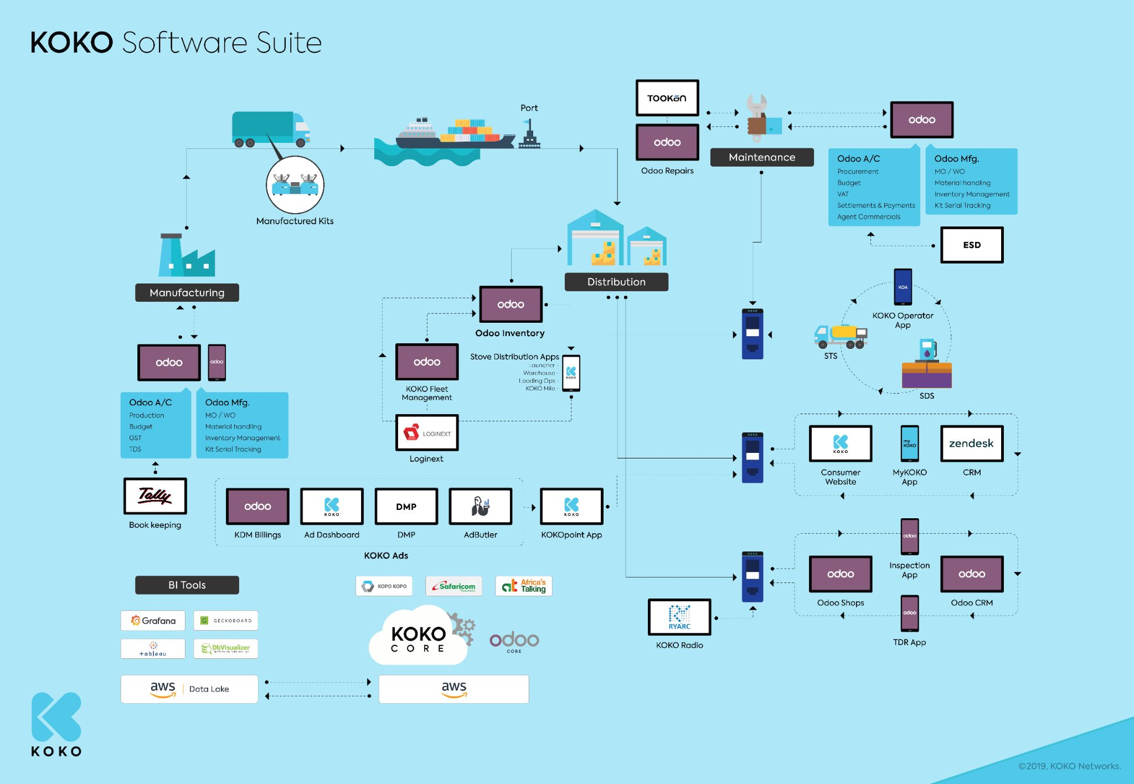
KOKO Software Landscape
Maintenance
Manufacturing
KOKO Ads
Distribution
BI Tools

Slide 62
KOKO Mobile Apps
These applications are designed to service business and end-users remotely through mobile devices connected to the internet.
The existing KOKO mobile apps include:
Tanker/KOKO operator app (KOA)
KOKO Mile app
KOKO Sales app (myKOKO)
The mobile apps are discussed in more detail in the following slides.

Slide 63
KOKO Mobile Apps
There’s need to understand the size of the user base of the 3 mobile apps being used by KOKO staff, as well as KOKO customers and agents. The approximate number of users of each is displayed below:
MOBILE APP | NO. OF USERS | USERS
Tanker/KOKO operator app (KOA) | 20 | 10 clerks, 6 dispatch ,4 warehouse, dispatch supervisor and warehouse supervisor
KOKO Mile app | 15 | 11 operators, fuel operations supervisor and 3 fuel ops assistants
KOKO Sales app (myKOKO) | 12,210 | Google Play Store installs

Slide 64
KOKO Operator App
KOKO Operations:
Fuel Operations
Functions:
Manage KP and tanker refills
Directions to KPs/depots (routing)
Status notifications and task states
The KOKO Operator application was developed to help in performing KOKO fuel operations. The KOA app is used to manage STS and KP refills. It helps in quality assurance at fuel depots and to direct micro tankers between fuel depots and KOKOpoints. It also helps to manage refill trips for tanker drivers and to send updates.
Detailed information about KOA is discussed in the KOKO operations section above, and also in the following links:
KOA in-app Updates
Skip KP refill task from KOA

Slide 65
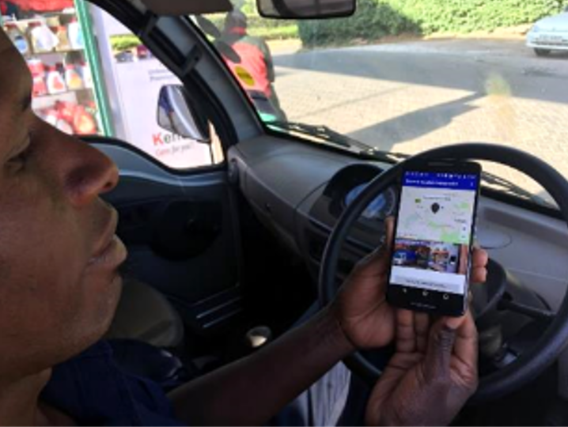
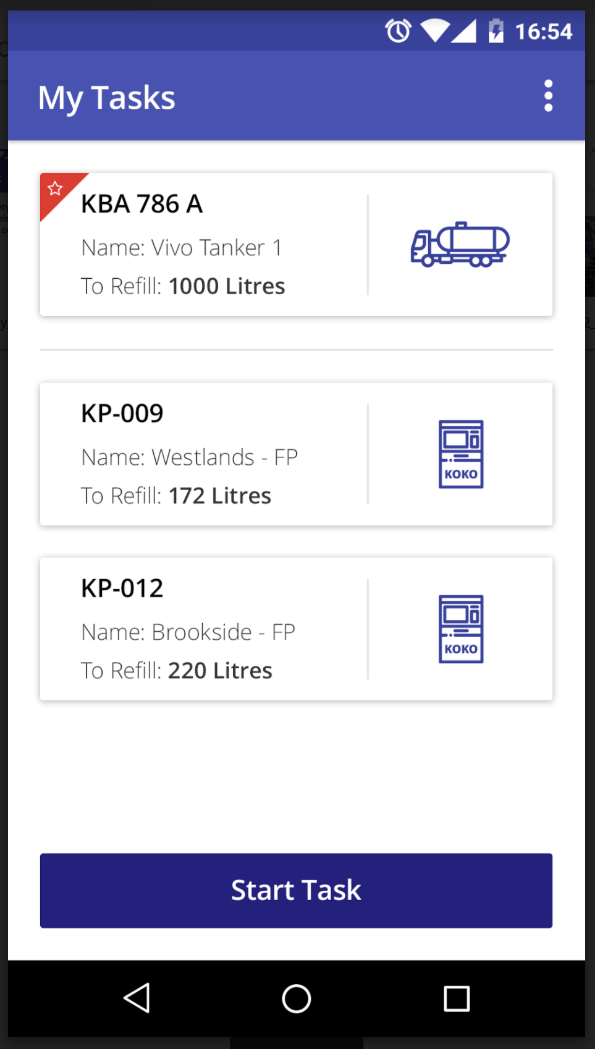
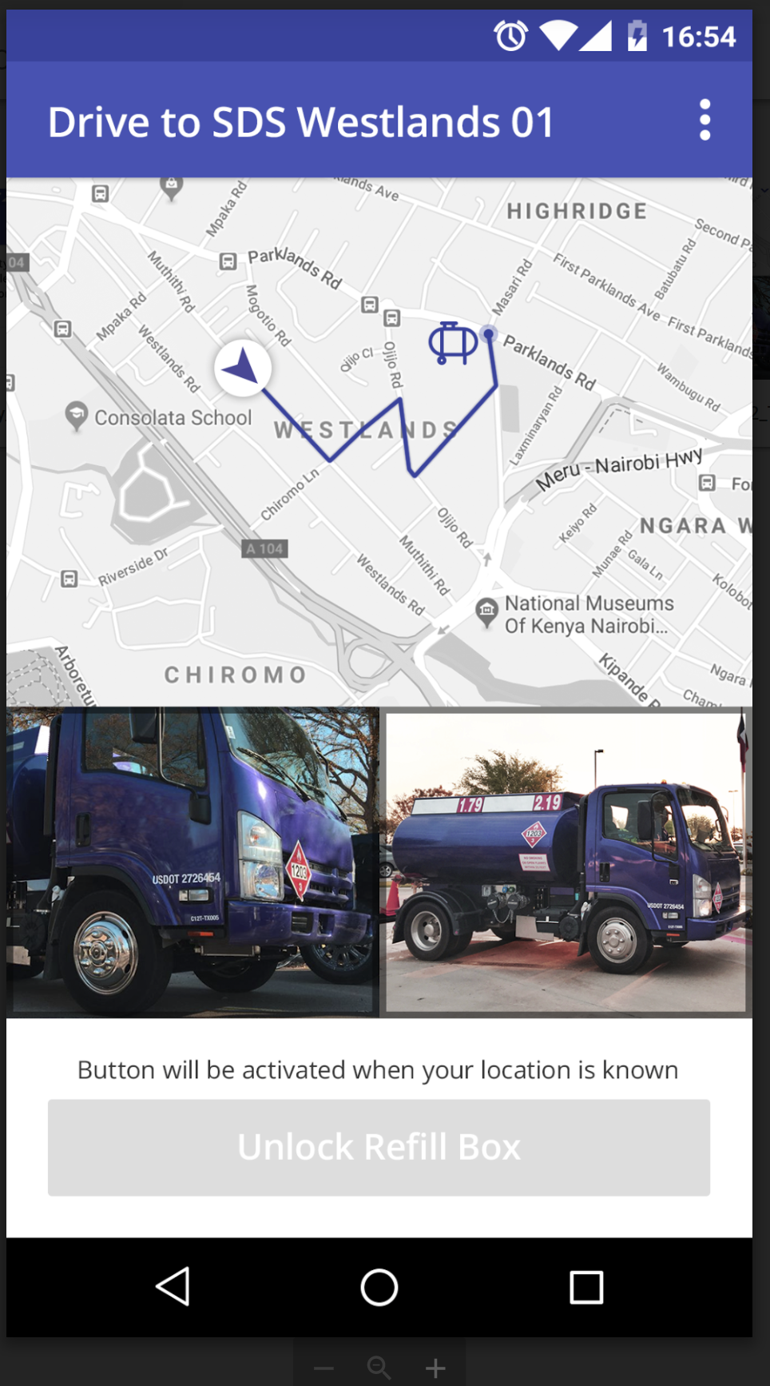
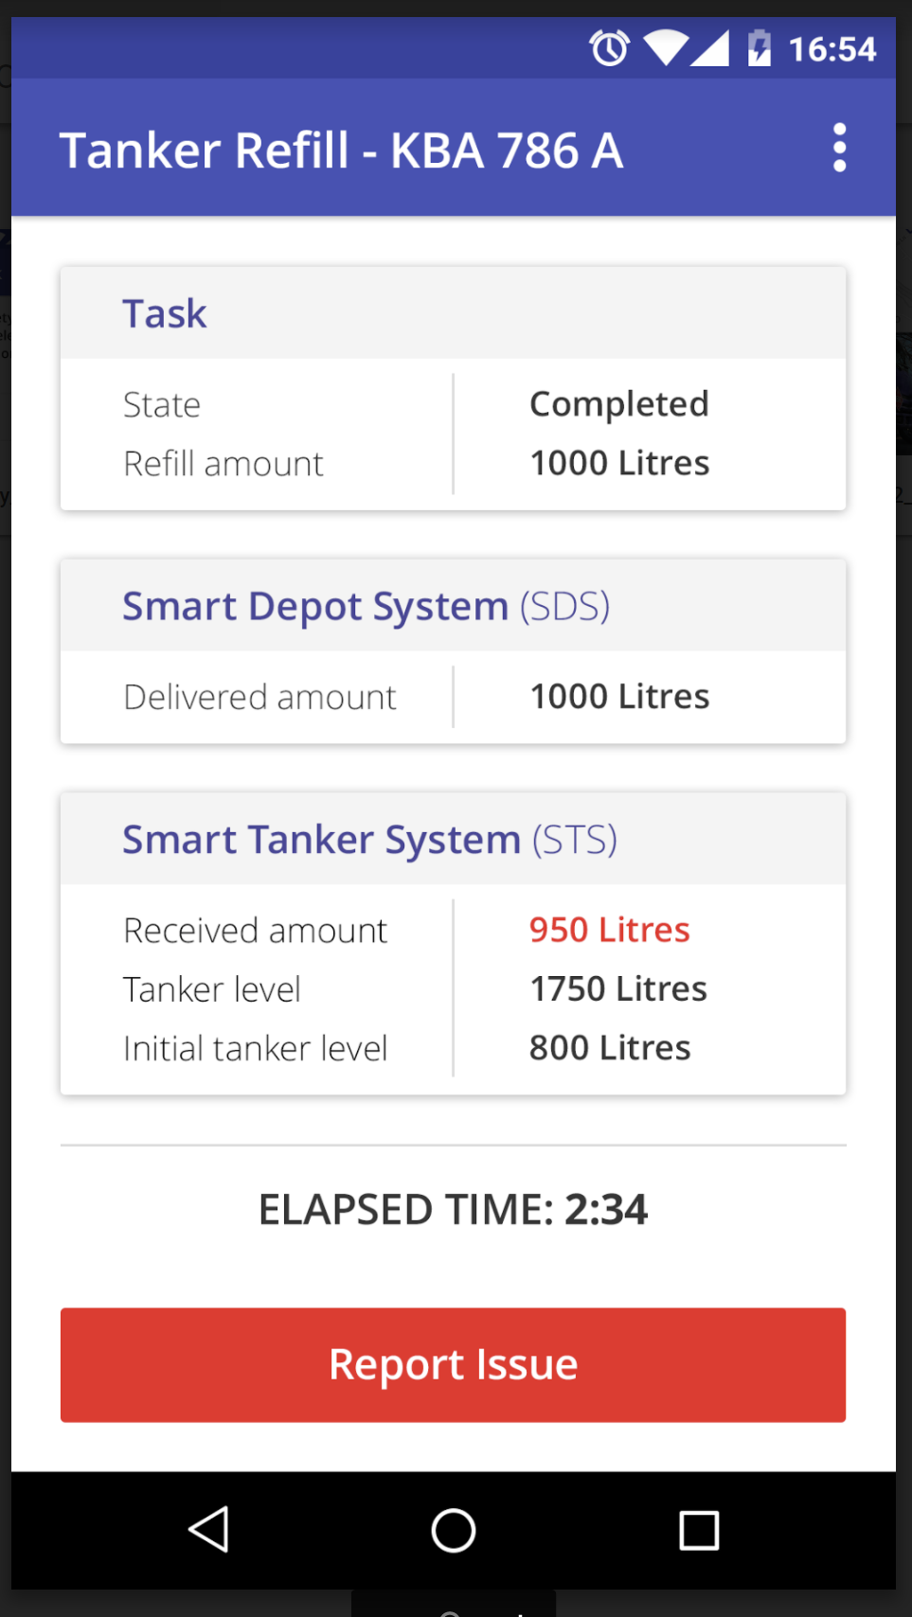
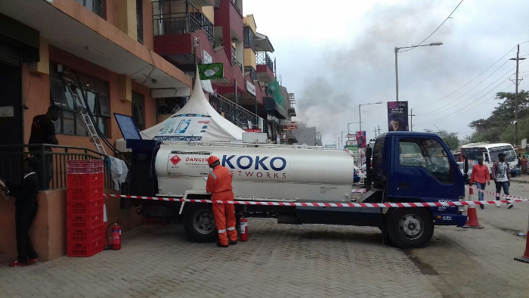

Tanker Operator App - Screenshots

Slide 66
KOKO Mile App
KOKO Operations:
Cooker Distribution
Functions:
Stocktaking
Cooker delivery
The KOKO Mile application was developed to support cooker operations. Cooker delivery drivers use the application to manage delivery tasks, and to manage the cooker inventory in the delivery trucks. At the KOKO agent shops, the drivers use the app to deliver the right number of cookers to each shop, as well as to take stock of the existing cookers in the shops.
Detailed information about KOKO mile is discussed in the KOKO operations section above, and also in the following links:
Cooker delivery through KOKO Mile
Stock take through KOKO Mile

Slide 67
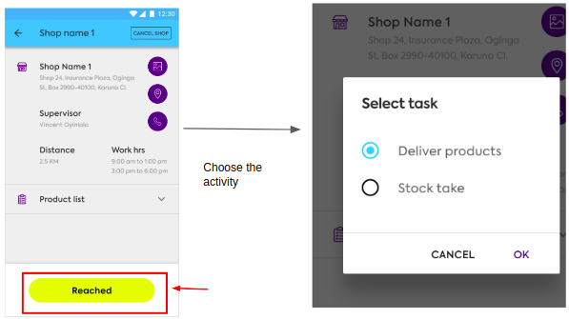
KOKO Mile App - Screenshots

Slide 68
KOKO Sales App (myKOKO)
KOKO Operations:
Agent Networks, Customer Sales
Functions:
Tracking Customer purchases
Placing orders for cooker kit
Tracking sales progress
Referral programme
The myKOKO sales app was designed to help increase KOKO cooker and fuel sales by providing a platform to support KOKO agents and household customers a platform to allow registration, direct cooker sales, customer profile management, as well as cooker saving and customer wallet management, among other customer facing features.
Relevant Links:
Sales App Scoping and Feature Specification
Sales App (My Koko) Fixes - RoadMap
MyKoko Sales App (V2) Improvements Deck
MyKoko Improvements progress checklist
MyKoko Improvements - Stories & Requirements
My KOKO - User Research (CSRs)

Slide 69
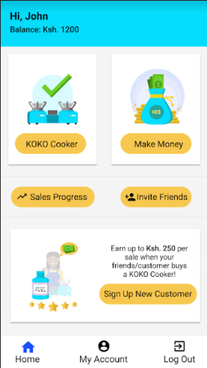
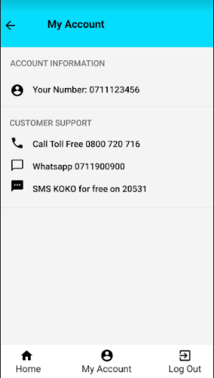
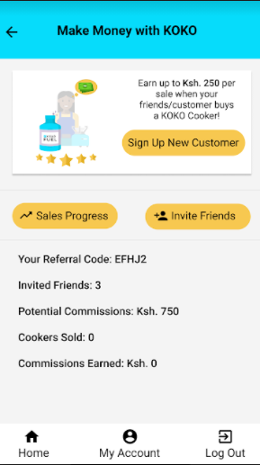
KOKO Sales App (myKOKO) - Screenshots

Slide 70
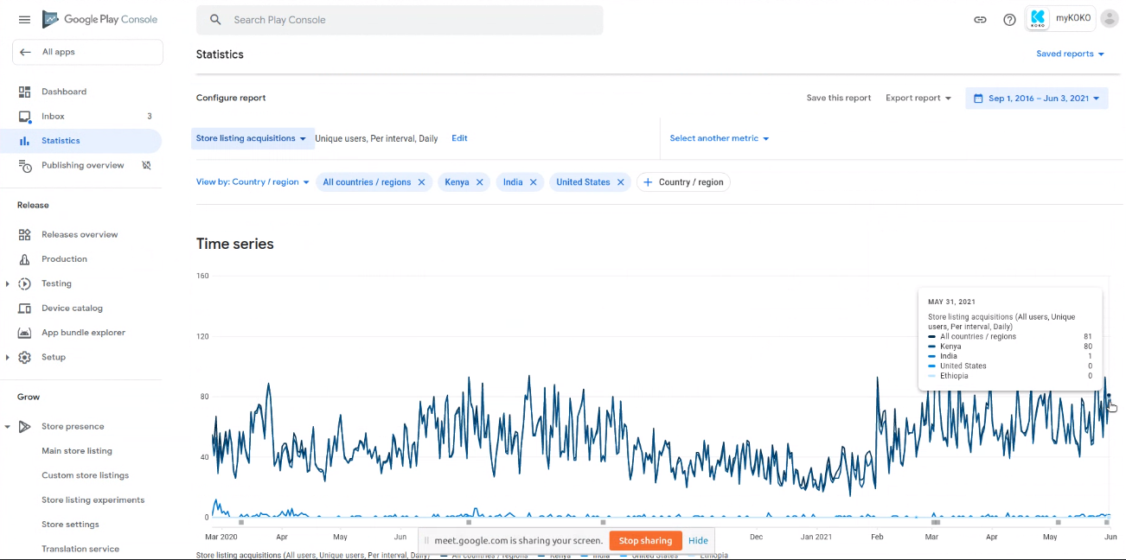
KOKO Sales App (myKOKO) - User Acquisitions

Slide 71
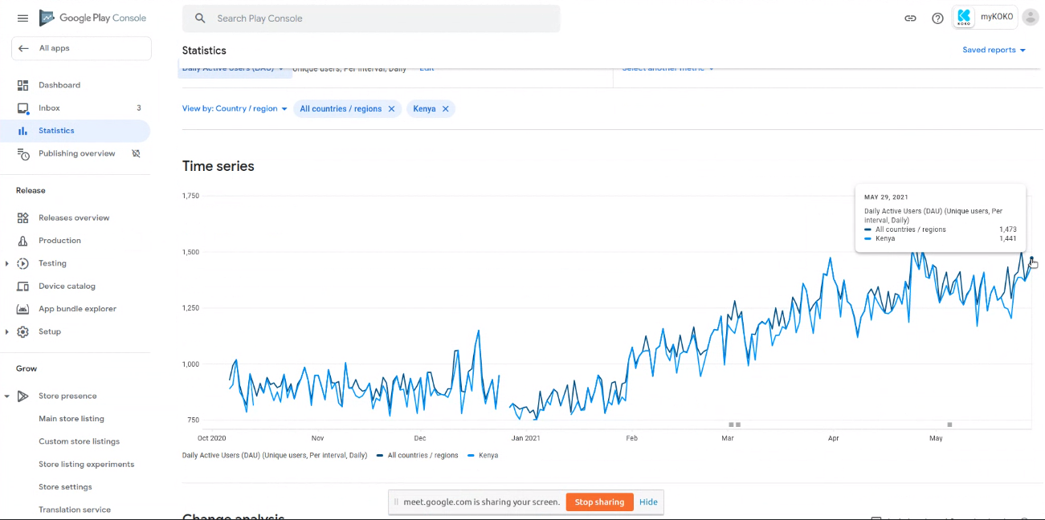
KOKO Sales App (myKOKO) - Daily Active Users

Slide 72
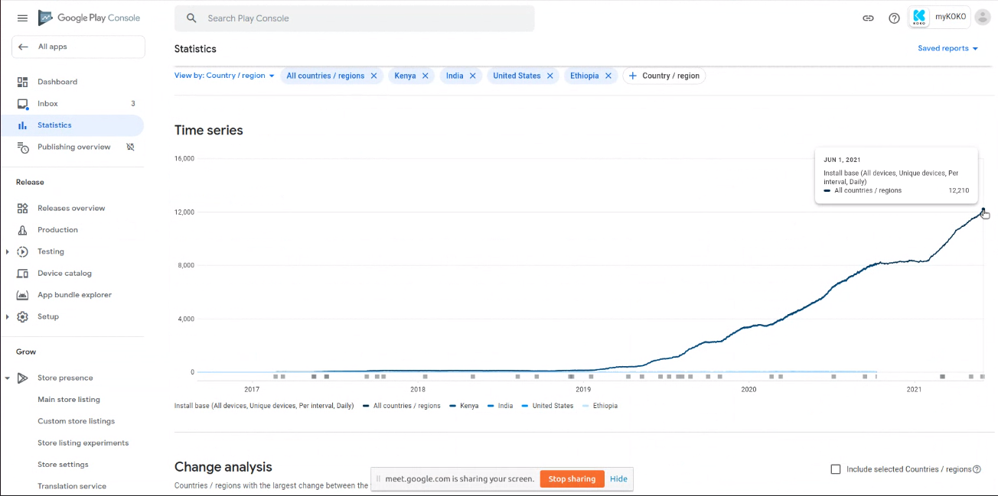
KOKO Sales App (myKOKO) - Install Base(All Devices)

Slide 73
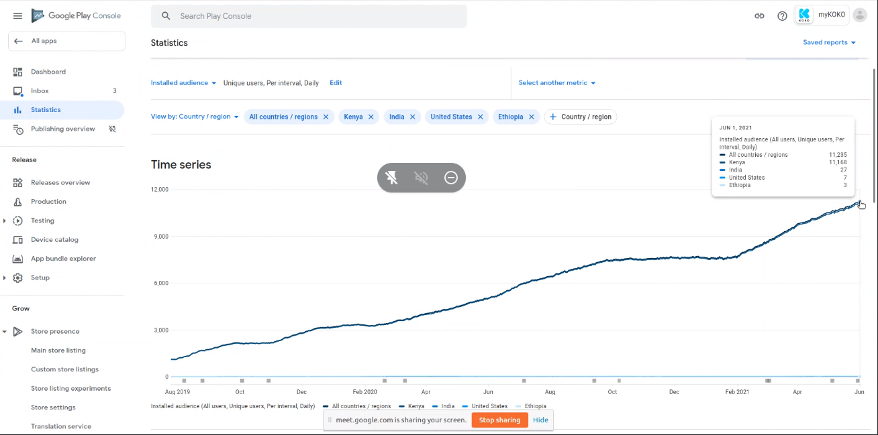
KOKO Sales App (myKOKO) - Install Base(Unique Users)

Slide 74
k.nyawallow@kokonetworks.com

